Slide 1
Slide 1
CEF 440 : INTERNET PROGAMMING AND MOBILE PROGRAMMING
MARKET MANAGEMENT SYSTEM
INSTRUCTOR : Dr NKEMENI VALERY

Slide 2
OUTLINE
A) SYSTEM REQUIREMENTS
Introduction
Functional requirements
Non-functional requirement
B) ANALYSIS
Overall description
Functionalities
Platform
System features

Slide 3
INTRODUCTION
Market Management software (MMS) is a mobile application that allows users (buyers and sellers ) to view available product in the market and their respective prices , availability and location. The application also allows sellers to upload their products and theirs respective prices , availability and location.

Slide 4
A) SYSTEM REQUIREMENTS SPECIFICATION
FUNCTIONAL REQUIREMENTS
Login/registration
Product search
product listing
User dashboard set up
Review and rating system
Notes:
4

Slide 5
NON-FUNCTIONAL REQUIREMENTS
Security
Performance
User interface
Support
Reliability
Availability
Notes:
5

Slide 6
B) ANALYSIS SPECIFICATION
Overall Description
Notes:
6

Slide 7
Functional Requirement
Users should be able to create an account with email ,password ,full names and user name
Users should be able to browse and search for products based on keywords and category,
Users should be able to view product details, such as descriptions, images, location, price and reviews.
Sellers should be able to add products to their shop
Sellers should be able to set their dashboard, profile description and upload a profile picture.
Notes:
7

Slide 8
Non-Functional Requirement
Availability: The app should have a goal of 99.9% availability to ensure Users can access anytime.
Correctness: The app should accurately display product information.
Maintainability: The app should be continuously integrated so that features, updates, and bug fixes can be deployed rapidly without downtime.
Usability: The interface should be intuitive and easy to navigate, allowing sellers to list and add products to their store and buyers to browse through without confusion.
Notes:
8

Slide 9
Platform
Framework : Django for backend / Bootstrap for frontend
IDE: Visual studio code
Hosting environment: Xampp Local host
Modelling software: ER-Builder and Modelio
Notes:
9

Slide 10
Hardware requirement
RAM : at least 4 Gb
Memory : at 15 Gb
Notes:
10

Slide 11
Programming languages
Back-end Technology: Python
Database Management system : MYSQL
Front-end Technology: HTML, CSS and JavaScript
Notes:
11

Slide 12
Design Methodology
Agile Methodology
Increase in Software Quality
Agile models breaks down the project into multiple, manageable units
Can help the development team to quickly respond to changes in customer requirement
Promote frequent testing and integration of new features, which is essential for a MMS
Allow faster and more efficient development, which is a successful launch of a MMS
User-Focused Process
Notes:
12

Slide 13
Description of use cases
Actors
Buyers(primary)
Sellersprimary)
Admin ( secondary)
Use cases
Registration
Login/logout
Add product
Manage product
Search product
Rating
Review
KYC
Notes:
13

Slide 14
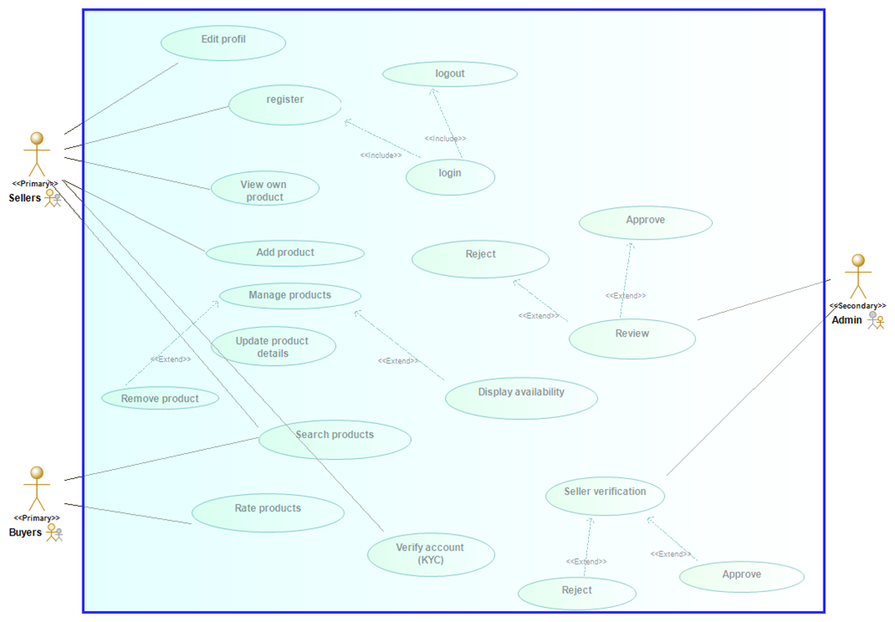
Description of Use cases
Notes:
14

Slide 15
Limitations
Purchases and payment: Integrating a payment system will be good but it was not integrated for the following reasons:
The buyers can pay for a product , then on reaching the market ,
The product is out of stocks.
The quality is not met as seen
The vendor is not available on reaching the market
You can find out that the vendor is not real or does not have a physical store.
Notes:
15

Slide 16
THANK YOU
Notes:
16

